Slide 1

Interfacing Fingerprint Sensor With Arduino Mega
Submitted by: Simran (C0765503)
Group: 2

Slide 2
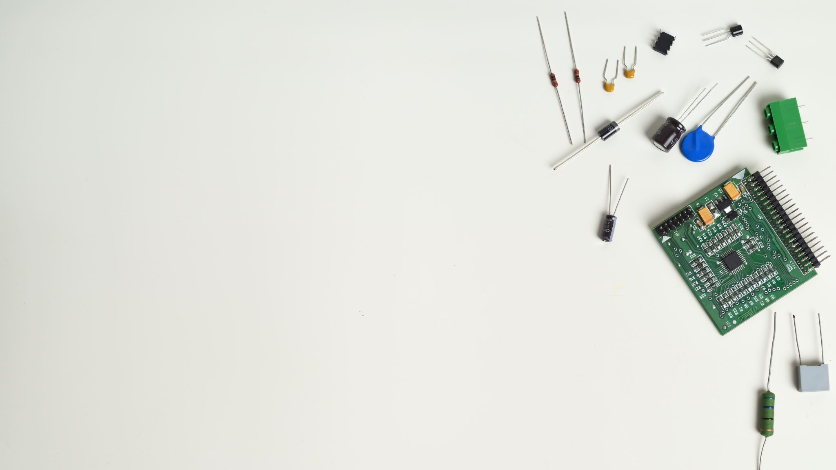
Why Interfacing is Important?
Interfacing help us to mix and match the different embedded components and attain the required results as per the user’s expectations.
For this part of the project, today I am going to perform interfacing of the fingerprint sensor with Arduino mega and the Communication protocol used between these two different embedded devices is UART.

Slide 3

UART Communication Protocol
UART is Universal Asynchronous receiver transmitter.
It is used to transmit the data in the form of packets .
For this project, we are using UART Communication protocol for Arduino mega and fingerprint module.

Slide 4
UART Communication Protocol
Arduino Mega has 4 UART Ports available, and we are using SERIAL 2 to perform the communication.
The Serial port 2 has pin 16- TX and Pin 17- RX
These pins are connected to the fingerprint module at odds to lead the UART communication possible.

Slide 5
Requirements for Interfacing
Hardware Requirements
Software Requirements
Fingerprint Sensor R307
Jumper wires
Arduino mega
Laptop
USB Cable
Arduino IDE

Slide 6

What is Fingerprint Sensor?
Fingerprint Sensor is the type of technology that helps to identifies and authenticates the fingerprints of an individual in order to grant or deny an access to the system.
Nowadays, Fingerprint scanner is used everywhere for security purposes.

Slide 7

Role of Fingerprint Sensor in my Project?
As I am working on the Project “ IOT BASED BANK LOCKER SECURITY SYSTEM”, here in this project, fingerprint sensor is used as a “Second Layer” security for the locker.
As the user, need to scan the required finger in order to open the locker.
As per the software coding, three chances will be given to the user.
If the user is somehow unable to scan the correct finger, then the user jumps to the first layer of security: touchscreen.

Slide 8
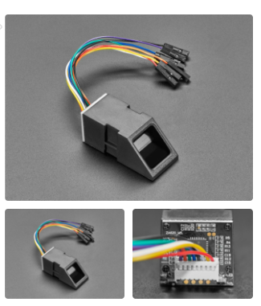
Fingerprint Sensor

Slide 9
Fingerprint Sensor R307
R307 Fingerprint Module consists of high-speed DSP processor, high-performance fingerprint alignment algorithm, high-capacity FLASH chips and other hardware and software composition, stable performance, simple structure, with fingerprint entry, image processing, fingerprint matching, search and template storage and other functions

Slide 10
Fingerprint Sensor R307
Here, for the project , we are using R307 Fingerprint sensor.
R307 fingerprint module is a fingerprint sensor with UART Communication Protocol.
The user can store up to 127 fingers in this module.
The FP module can directly interface with 3.3 or 5v Microcontroller. For this project we are using it using Arduino Mega.

Slide 11

Features of Fingerprint Sensor R307
Supply voltage: DC 4.2 ~ 6.0V
Working current: 50mA (typical)
Peak current: 80mA
Fingerprint image input time: <0.3 seconds
Window area: 14x18 mm
Matching mode:1: 1 and 1:N
Communication Protocol: UART

Slide 12
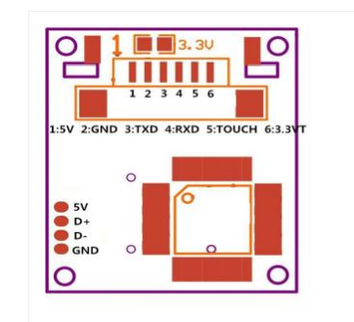
Pinout of R307
Here is the pin layout of the fingerprint Module R307.
There are 6 pins in the module with different color wires.
The color of the wires determines the pins of the module.

Slide 13
Arduino Mega
Arduino mega 2560 R3 is the microcontroller unit in the embedded industry, which is the exact replica of Arduino UNO, but with a greater number of input/output pins and communication protocol.
For, this project, we are using Arduino mega as a slave device.
We are connecting the fingerprint module with the Arduino mega using UART Communication protocol.

Slide 14
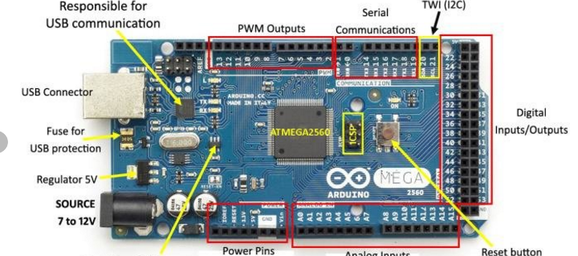
Arduino Mega

Slide 15
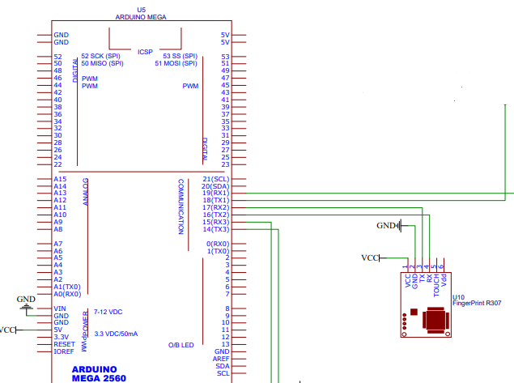
Schematic Design

Slide 16
Hardware Connections
Fingerprint Sensor | Arduino mega
GND | GND
VCC | VCC
RX(WHITE WIRE) | PIN 16 (TX2)
TX(YELLOW WIRE) | PIN 17 (RX2)

Slide 17
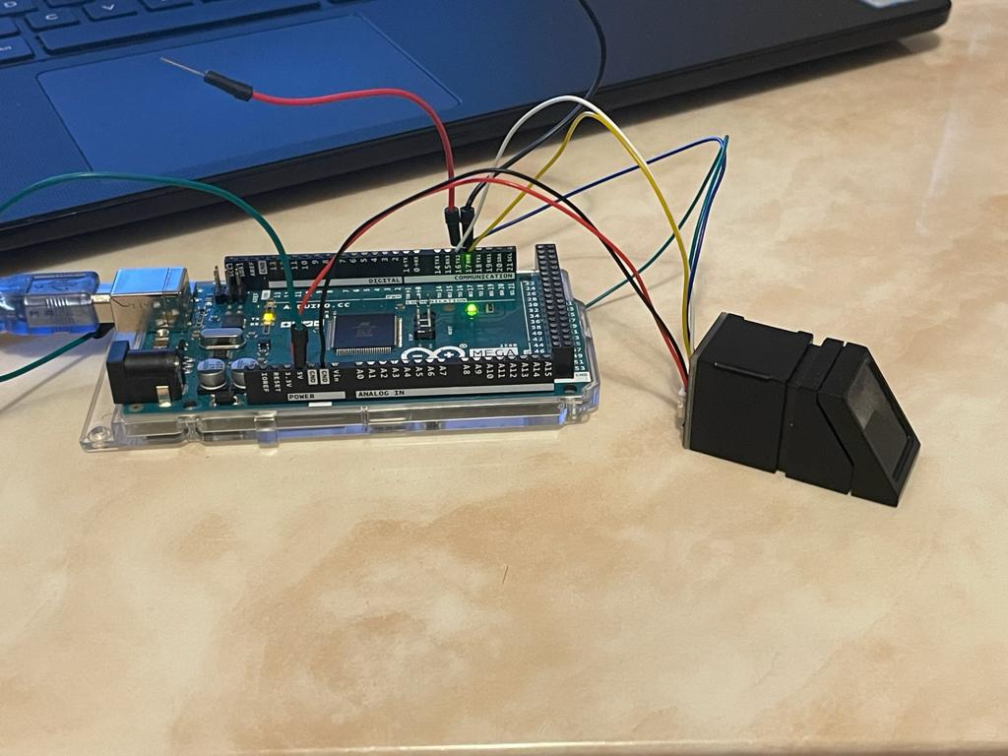

Slide 18
Arduino IDE
Arduino IDE is used in as a software in this interfacing to flash the code in the Arduino.
Firstly, we install the “ADAFRUIT FINGERPRINT LIBRARY” from the sketch menu.
After installation, the Example codes are available, which, are used to perform this task.
LIBRARY” from the

Slide 19
Adding library in the IDE

Slide 20
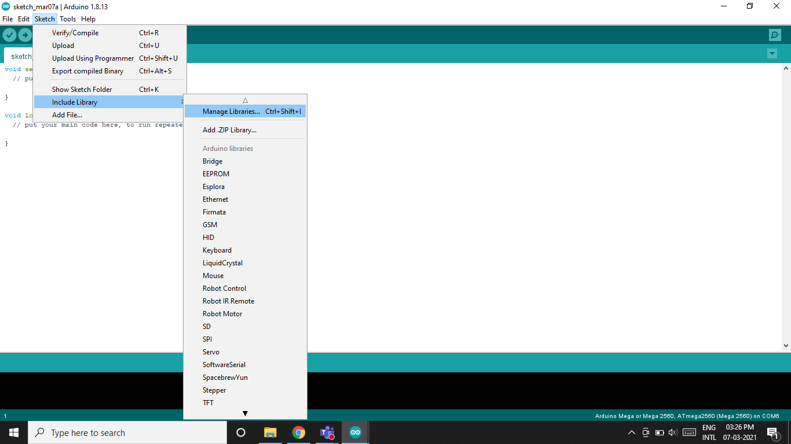

Slide 21
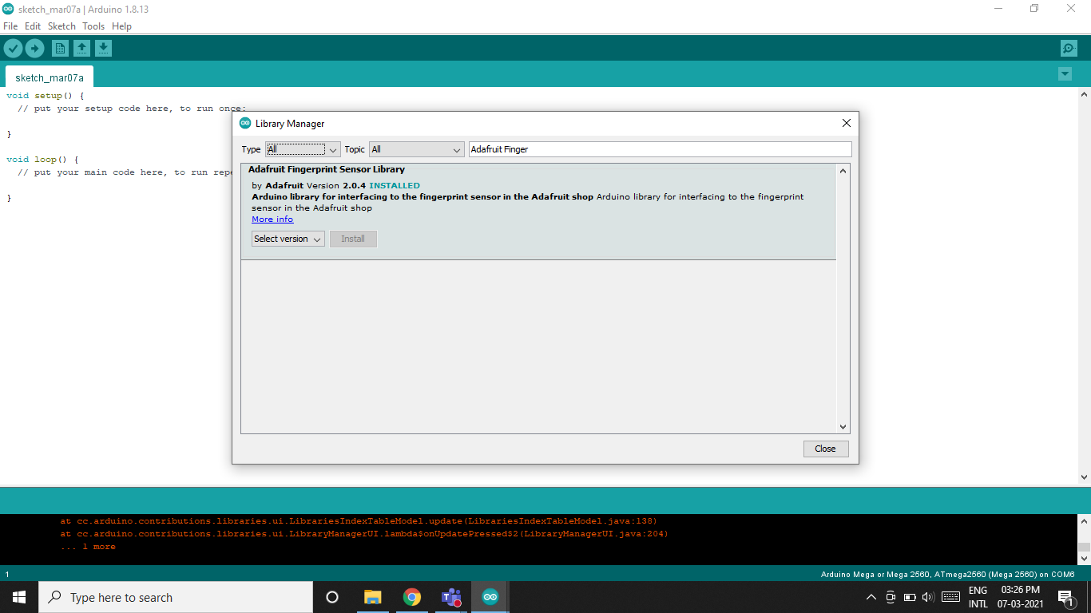
REQUIRED LIBRARY FOR FINGERPRINT SENSOR

Slide 22
Coding

Slide 23
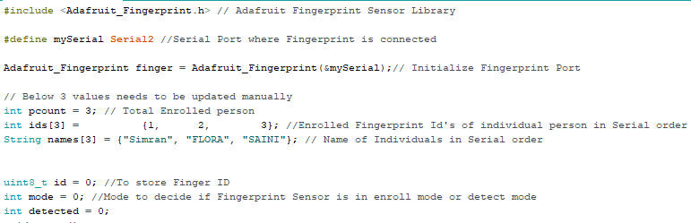
Initialization

Slide 24
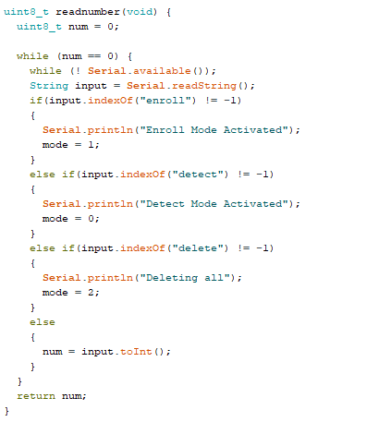
Modes

Slide 25
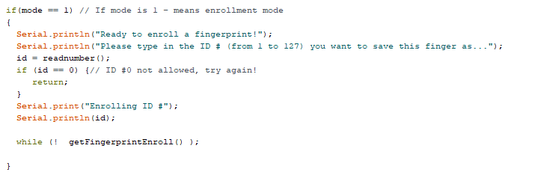
Coding for enrollment

Slide 26
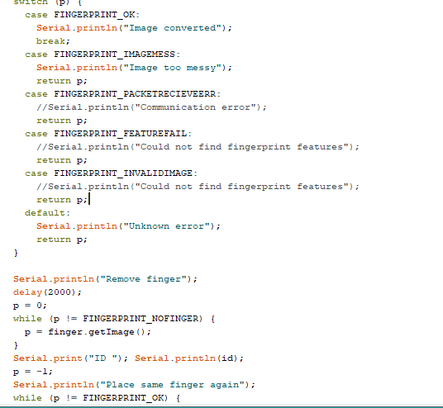

Slide 27
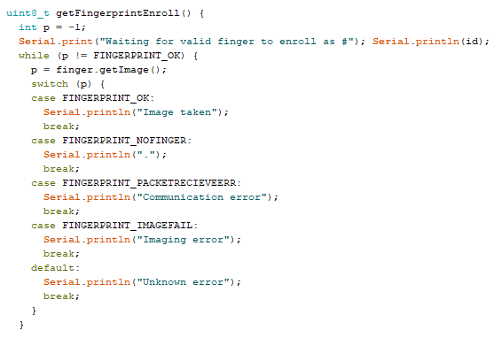

Slide 28
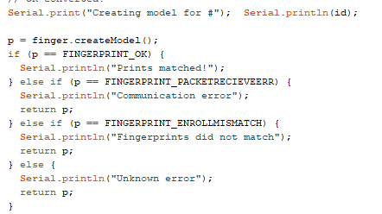

Slide 29
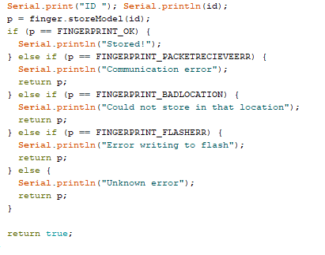

Slide 30
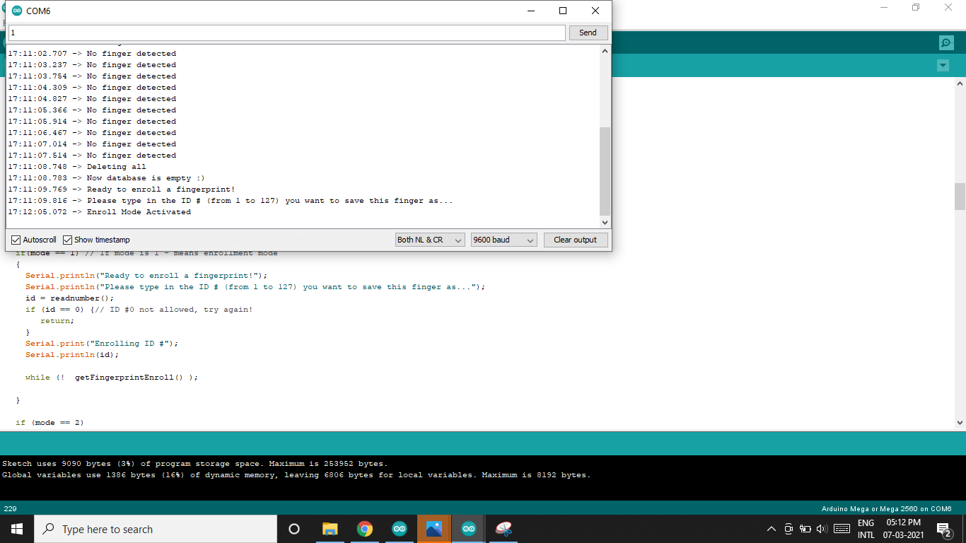
Output of Enrolled Fingerprint

Slide 31


Output of Enrolled Fingerprint

Slide 32

Output of Enrolled Fingerprint

Slide 33
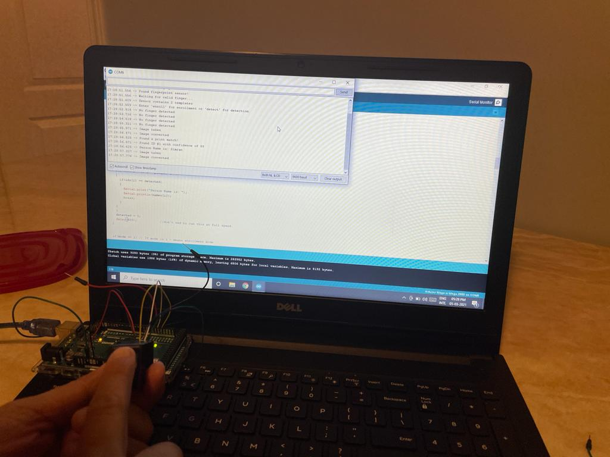
Output of Enrolled Fingerprint

Slide 34

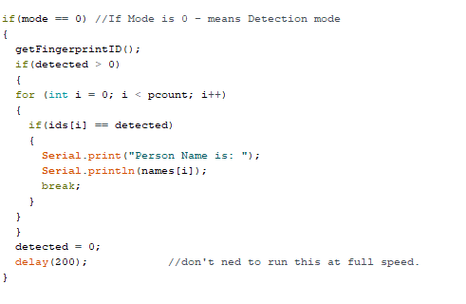
Detecting the stored Fingerprint

Slide 35
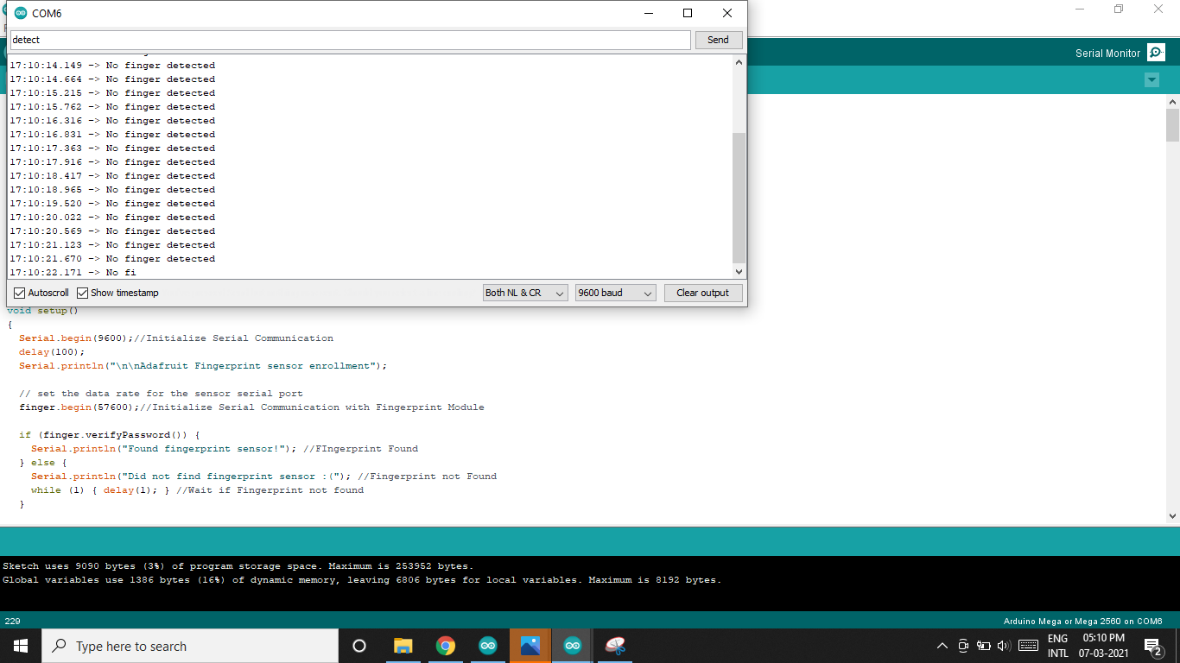
Output of Detected fingerprint

Slide 36
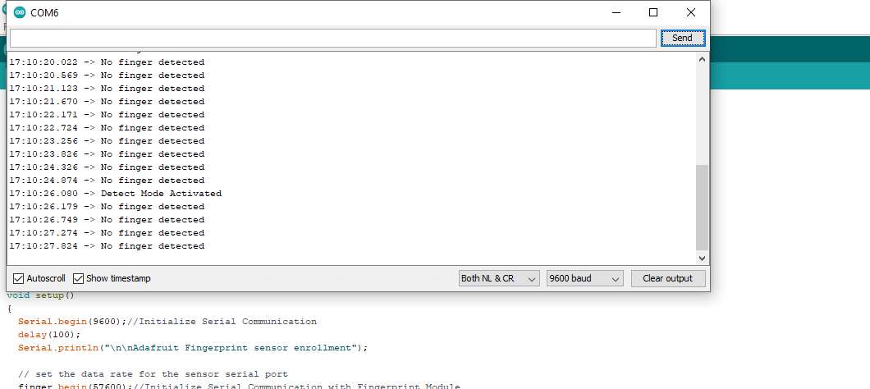
Output of Detected fingerprint

Slide 37
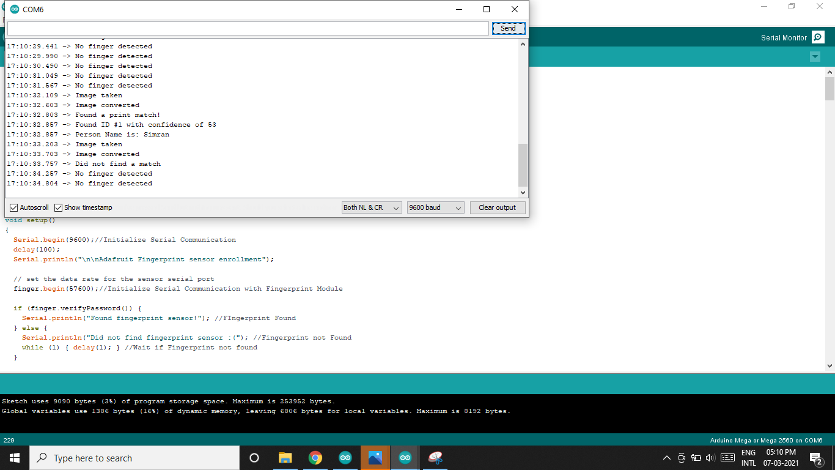
Output of Detected fingerprint

Slide 38
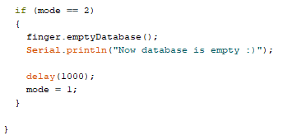
Deleting the stored Fingerprint

Slide 39

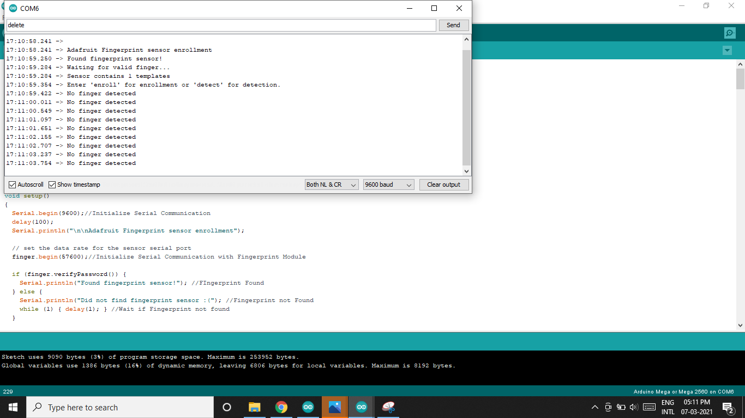

Output of Deleted fingerprint

Slide 40

Output of Deleted fingerprint

Slide 41
Things to Remember
Make sure to always select the correct port for the required microcontroller.
Always make the connections first and then give the supply to the controller, sometimes wrong connections leads to damage.
Always check for the required libraries first before doing any coding.

Slide 42
References
Fingerprint sensor R307: https://www.amazon.ca/Fingerprint-Reader-Multifunction-Optical-Deposit/dp/B08W4LCYXW/ref=sr_1_2?dchild=1&keywords=r307+finger&qid=1613045142&sr=8-2
Manual: https://www.openhacks.com/uploadsproductos/r307_fingerprint_module_user_manual.pdf
Interfacing fingerprint with Arduino mega: https://www.c-sharpcorner.com/article/fingerprint-lock-using-arduinomega2560/
Video link: https://www.youtube.com/watch?v=uY2tQXJQ0rM
Basic idea: https://learn.adafruit.com/adafruit-optical-fingerprint-sensor?view=all

